Slide 1
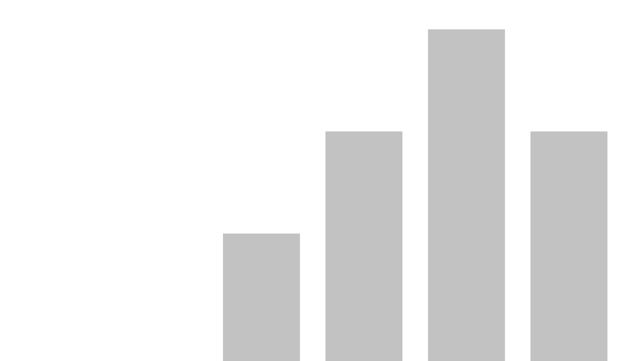


Gender Pay Gap 2021-2024
View in Power BI
Last data refresh:
07/01/2025 09:40:53 UTC
Downloaded at:
07/01/2025 09:55:23 UTC

Slide 2
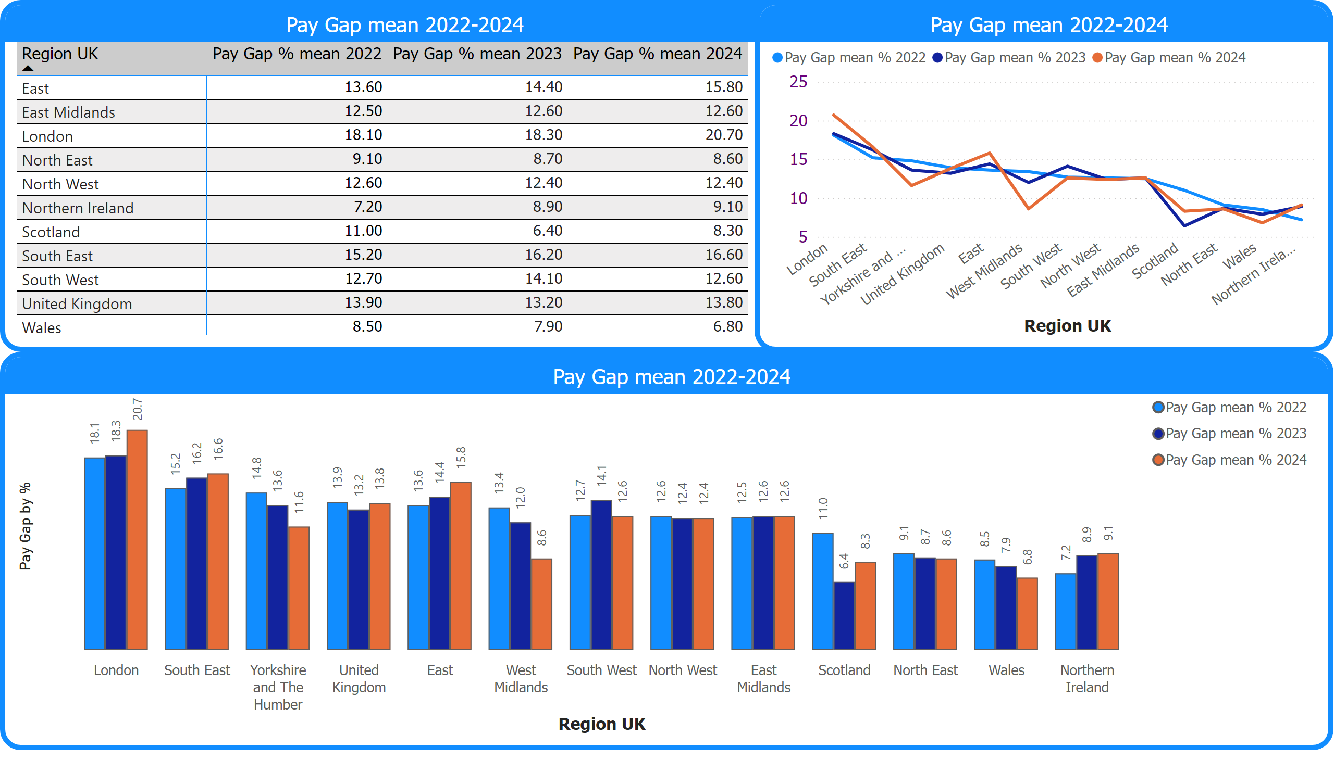
Pay Gap mean 2022-2024
Notes:
Pay Gap mean 2022-2024
No alt text provided
Pay Gap mean 2022-2024
No alt text provided
Pay Gap mean 2022-2024
No alt text provided

Slide 3
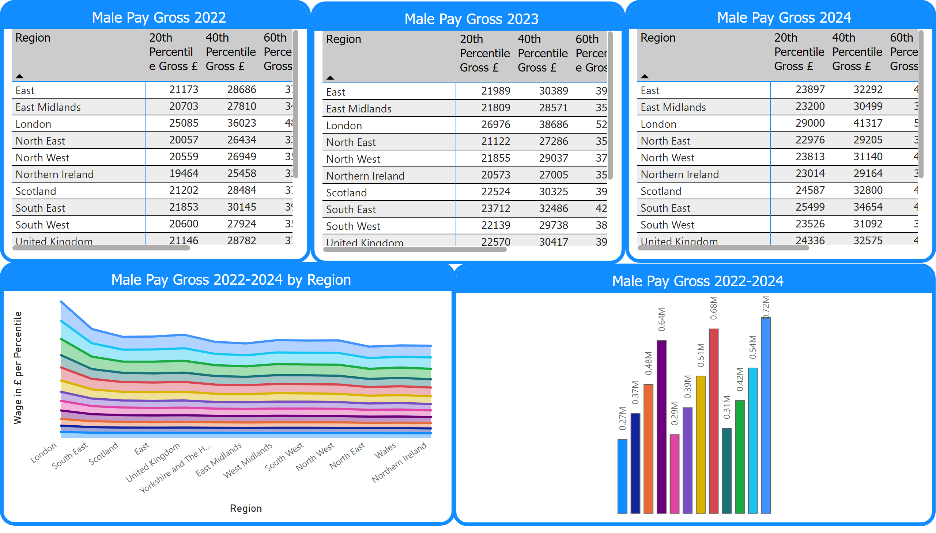
Male Wage by Region 2022-2024
Notes:
Male Pay Gross 2022
No alt text provided
Male Pay Gross 2022-2024 by Region
No alt text provided
Male Pay Gross 2023
No alt text provided
Male Pay Gross 2024
No alt text provided
Male Pay Gross 2022-2024
No alt text provided

Slide 4
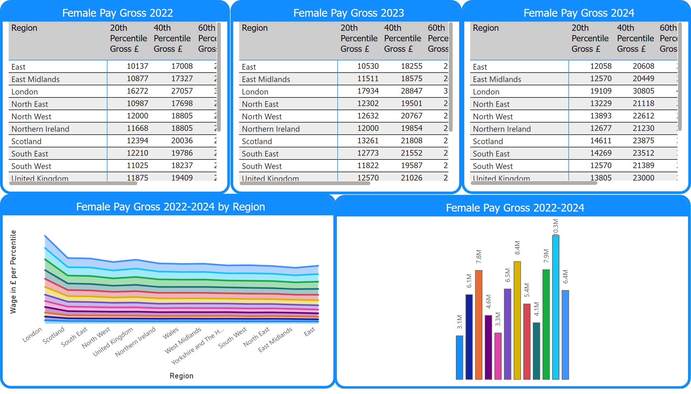
Female Wage by Region 2022-2024
Notes:
Female Pay Gross 2022
No alt text provided
Female Pay Gross 2022-2024 by Region
No alt text provided
Female Pay Gross 2022-2024
No alt text provided
Female Pay Gross 2023
No alt text provided
Female Pay Gross 2024
No alt text provided

Slide 5
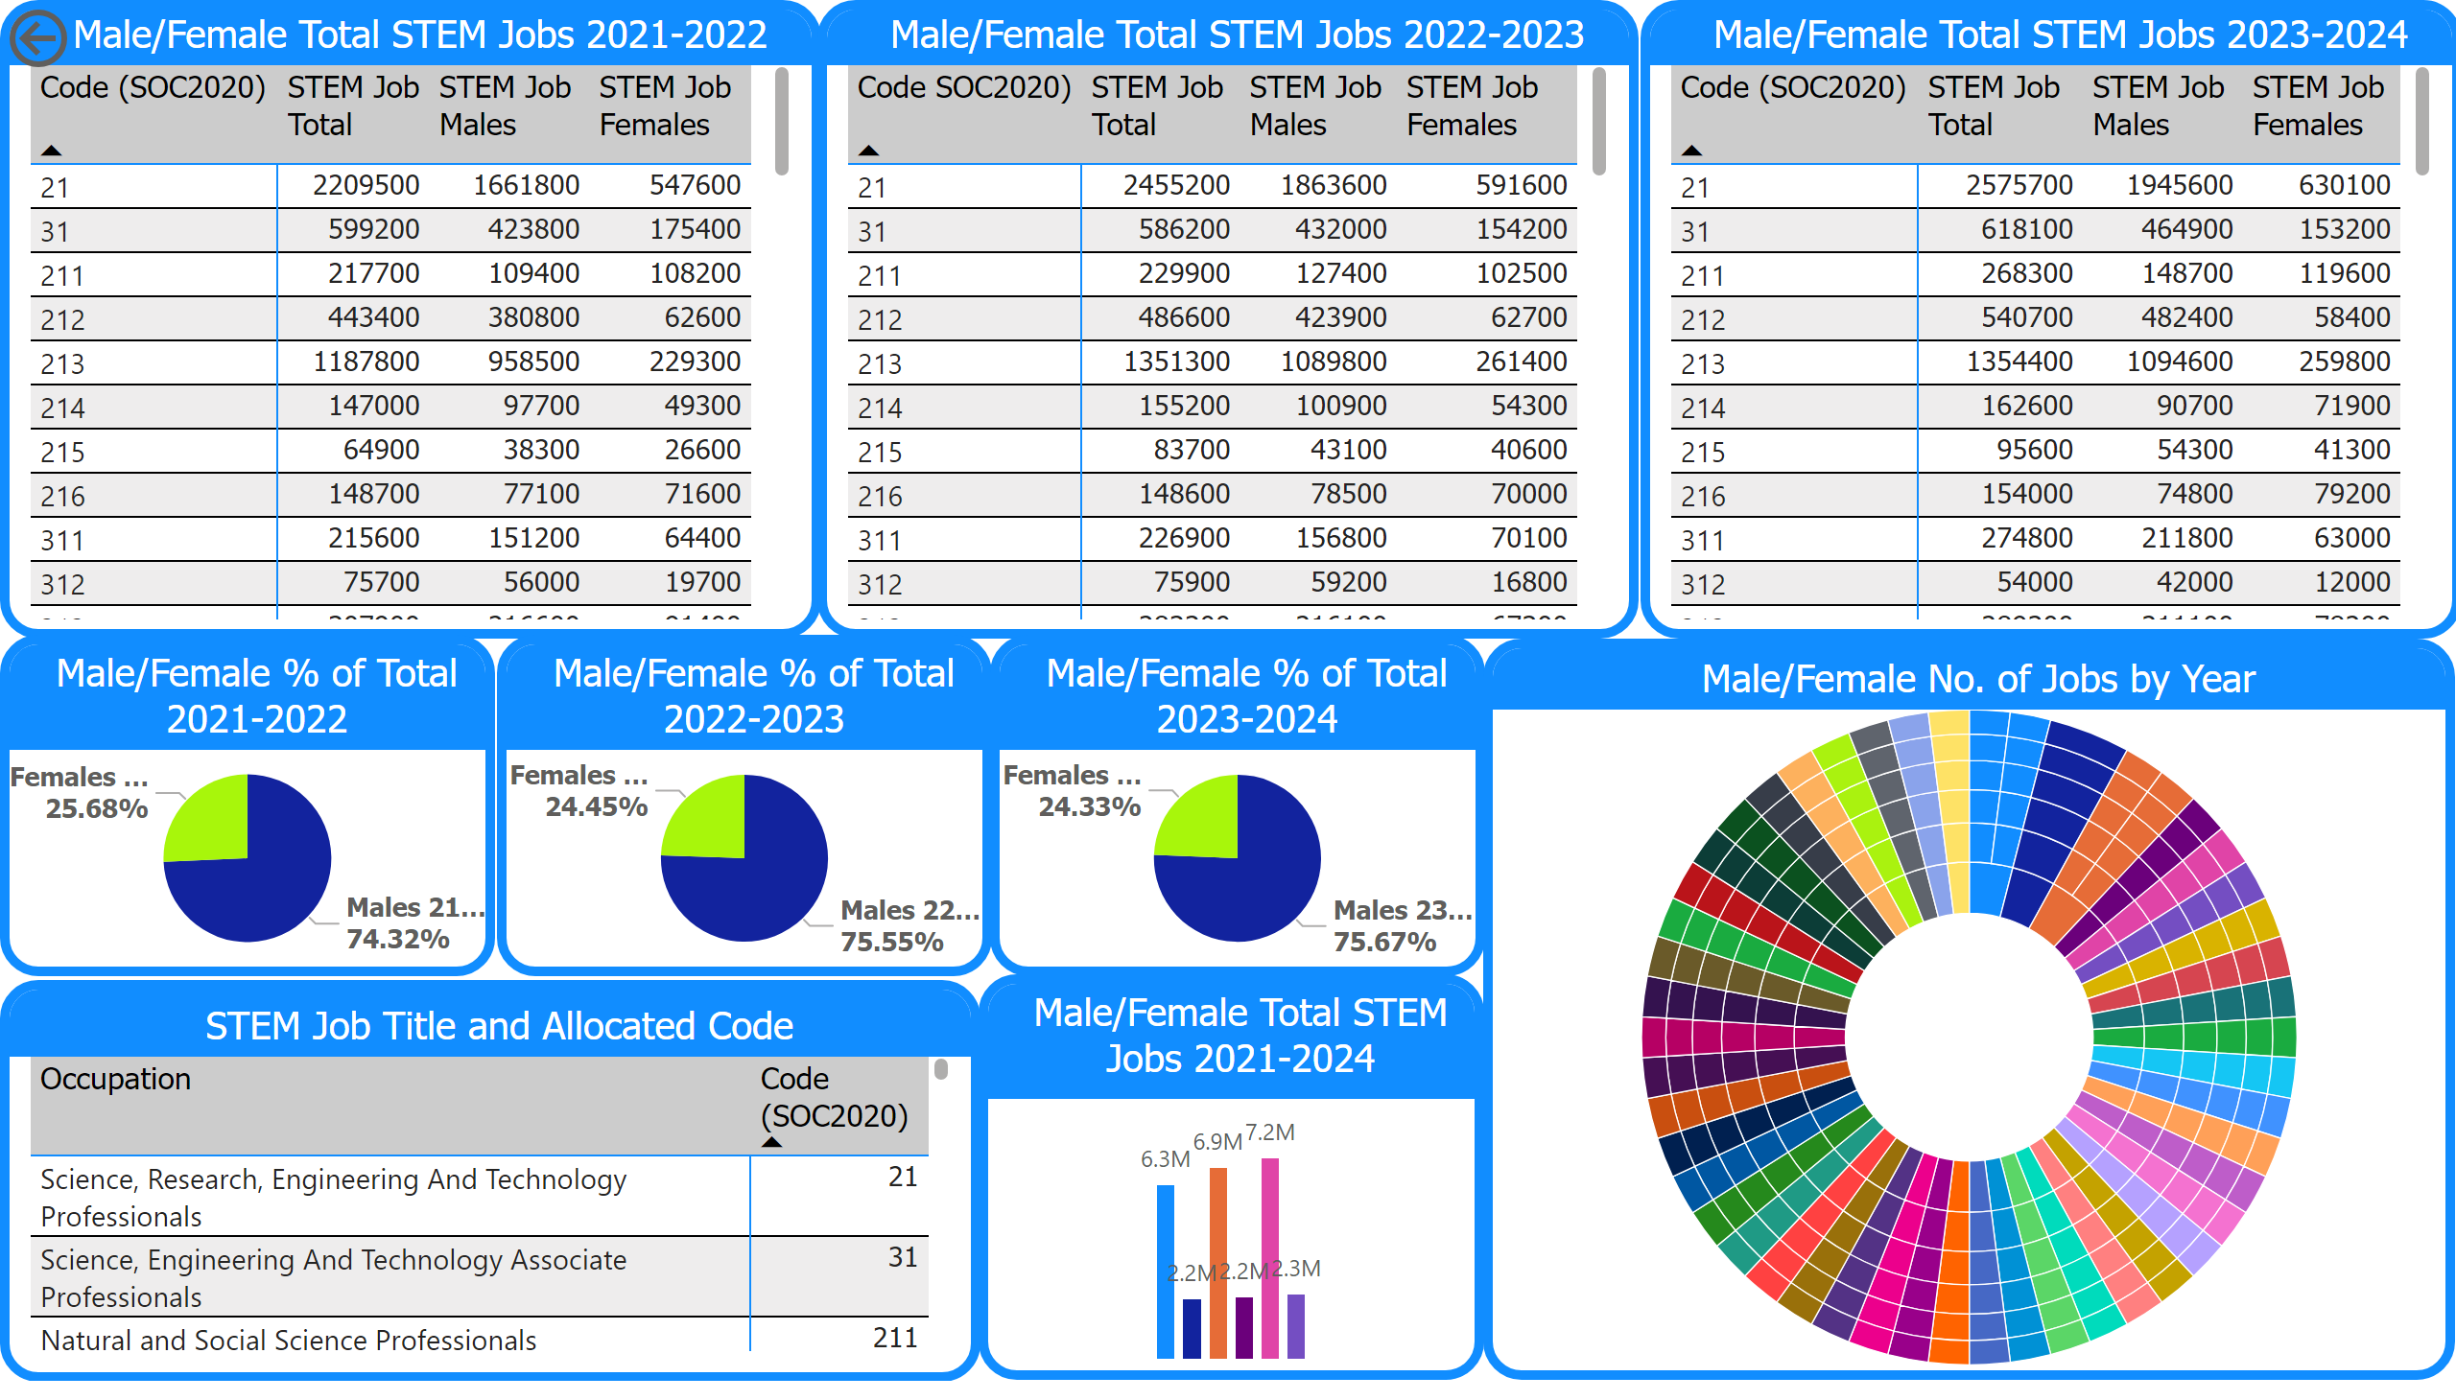
STEM Jobs Male to Female Ratio
Notes:
Male/Female Total STEM Jobs 2021-2022
No alt text provided
STEM Job Title and Allocated Code
No alt text provided
Male/Female % of Total 2021-2022
No alt text provided
Male/Female Total STEM Jobs 2022-2023
No alt text provided
Male/Female Total STEM Jobs 2023-2024
No alt text provided
actionButton
No alt text provided
Male/Female % of Total 2022-2023
No alt text provided
Male/Female % of Total 2023-2024
No alt text provided
Male/Female Total STEM Jobs 2021-2024
No alt text provided
Male/Female No. of Jobs by Year
No alt text provided

Slide 6
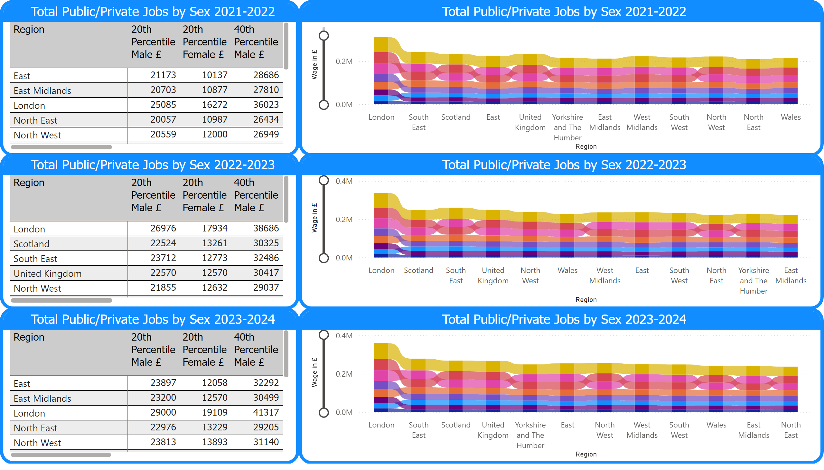
Public/Private Wage by Sex
Notes:
Total Public/Private Jobs by Sex 2021-2022
No alt text provided
Total Public/Private Jobs by Sex 2022-2023
No alt text provided
Total Public/Private Jobs by Sex 2023-2024
No alt text provided
Total Public/Private Jobs by Sex 2022-2023
No alt text provided
Total Public/Private Jobs by Sex 2023-2024
No alt text provided
Total Public/Private Jobs by Sex 2021-2022
No alt text provided

